Slide 1
CSS

Slide 2
CSS
CSS, or Cascading Style Sheets, is a fundamental styling language used in web development to control the presentation and layout of HTML (Hypertext Markup Language) documents.
It was propose for the concept of separating structure (HTML) and presentation (styles) by Håkon Wium Lie and Bert Bos in 1994.

Slide 3
The Purpose of CSS
Separation of Concern:
HTML focuses on the structure and semantics of content, while CSS handles the styling and layout. This separation makes code more modular, maintainable, and adaptable to different devices and screen sizes.
Consistent Styling:
CSS enables consistent styling across multiple pages of a website. By creating a set of style rules, you can apply a unified look and feel, maintaining brand consistency.
Responsive Design:
With the rise of various devices, from desktop computers to smartphones and tablets, responsive design is crucial. CSS plays a pivotal role in creating layouts that adapt to different screen sizes and resolutions.

Slide 4
CSS and HTML Integration
To apply CSS to an HTML document, you can use various methods:
Inline Styles: Apply styles directly within HTML tags using the style attribute.
<p style="color: blue; font-size: 18px;">This is a styled paragraph.</p>
Internal Styles: Embed CSS within the HTML document using the <style> tag in the document's head.
<head> <style> p { color: red; font-size: 20px; } </style> </head>
External Styles: Define within <link> element. Create a separate CSS file (style.css) and link it to the HTML document using the <link> tag.
<head> <link rel="stylesheet" type="text/css" href="styles.css"> </head>
Note 1: If the same selector (attribute) in different style sheets is declared, the value from the last read style sheet will be used.
Note 2: If the internal style is defined after the link (external style), the internal style will be get privilege.
Note 3: Inline style has the highest priority and will override external & internal style.

Slide 5
For more extensive styling and improved organization, developers often leverage external CSS files or internal styles in conjunction with inline styles.

Slide 6
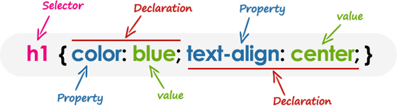
CSS Syntax
CSS Syntax consist of two parts
Selectors: Selectors are elements to which you want to apply styles. Elements can be
tags(h1, p, etc),
classes (prefixed with a dot, e.g., .container),
IDs (prefixed with a hash, e.g., #header),
Declaration: Declaration is the key-value pair of a CSS property, defining how the selected elements should appear. Properties can be color, font-size, margin, padding, and many others.

Slide 7
CSS Syntax
/* Styling a heading */
h1 { color: #4285f4; font-family: 'Arial', sans-serif; text-align: center; }
The selector “h1” points to the HTML element you want to style.
Each declaration consists of a property and a value separated by a colon (:) and ending with a semicolon (;), and the declaration groups are surrounded by curly braces {}.
CSS property names and many values are not case-sensitive. Whereas, CSS selectors are usually case-sensitive.
A CSS comment begins with /*, and ends with */

Slide 8
CSS Selector
A CSS selector selects the HTML element(s) you want to style. Selector can be
Element Selector: The element selector selects HTML elements based on the element name.
p { text-align: center; color: red; }
Attribute Selector: Element attribute selectors are used to style elements,such as class and id
id Selector: The id selector uses the id attribute of an HTML element to select a specific element. The id of an element is unique within a page.
#para1 { text-align: center; color: red; }
class Selector: The class selector selects HTML elements with a specific class attribute.
.center { text-align: center; color: red; } /* class centre will be red and centre-aligned */
p.center { text-align: center; color: red; } /* only <p> elements with class="center" will be */
HTML elements can also refer to more than one class.
<p class="center large">This paragraph refers to two classes.</p>
Universal Selector: The universal selector (*) selects all HTML elements on the page.
* { text-align: center; color: blue; }
Grouping Selector: Group selector have the same style to minimize code
h1, h2, p { text-align: center; color: red; }

Slide 9
DIV Selector
<div> is a non-semantic block level element, allows you to group related content together.
Styling:- You can apply range of style on all elements grouped in <div>. Instead of applying styles to each individual element (like paragraphs or images), you can wrap them in a <div> and apply styles to the container.
Positioning:- You can manipulate the position of all elements all-together, grouped in <div>.
<div class=“Home">
<header>
<nav> </nav>
<header>
<main>
</main>
<footer>
</footer>
</div>
Layout Management: It helps in creating flexible layouts that can adapt to different screen sizes and orientations.

Slide 10
https://www.tutorialrepublic.com/css-tutorial/
https://www.w3schools.com/css/

Slide 11
CSS Selector(pattern matching)
In CSS, pattern matching rules determine which style rules apply to elements in the document tree. These patterns, called selectors. In CSS, different types of selectors can be
universal-selector * {}
id selector # {}
class selector . {}
descendant parent-selector child-selector {}

Slide 12
Child Selector
The child selector in CSS (>) targets elements that are direct children of a specified parent element.
body > p {color: green;} //simple child selector
Here p is directly child of body
body > div > div > p {background: cyan;} //multiple child selectors
Here p is direct child of div, dive is direct child of another div and that dive is child of body
The :nth-child() selector in CSS allows you to target elements based on their position among siblings.
element:nth-child(n) { /* styles */ }
n is a formula, which can be a number, keyword, or expression.
p:nth-child(2n) { color: blue; } Selecting every second element:
li:nth-child(3) { font-weight: bold; } Selecting the third element:

Slide 13
Child Selector
The :first-child selector is used to select the specified selector, only if it is the first child of its parent.
p:first-child { font-weight: bold; color: blue; }
In this example, the first <p> element within its parent will be bold and blue.

Slide 14
Tools and Resources
Text Editors:
Use text editors like Visual Studio Code, cursor AI, antigravity, Sublime Text, or Atom to write and edit HTML and CSS files.
Browsers Developer Tools:
Modern browsers come with built-in developer tools (e.g., Chrome DevTools, Firefox Developer Tools) that allow you to inspect and debug your HTML and CSS.
Online Resources:
Utilize online resources like MDN Web Docs (Mozilla Developer Network), W3Schools, and CSS-Tricks for learning and reference.

Slide 15
Color Styling
Color in CSS can be defined as
RGB Color:- rgb(red, green, blue) = rgb(0-255, 0-255, 0-255)
RGBA Color:- rgba(red, green, blue, alpha) = rgba(0-255, 0-255, 0-255, 0.0-1.0)
The alpha parameter specify the opacity for a color.
Hex Color:- #rrggbb where rr equal to red, gg equal to green, bb equal to blue are hexadecimal value between 00 to ff (0 to 255)
HSL Color:- hsl(hue, saturation, lightness)
Hue is a degree on the color wheel from 0 to 360. 0 is red, 120 is green, and 240 is blue.
Saturation is a percentage value. 0% means a shade of gray, and 100% is the full color.
Lightness is also a percentage value. 0% is black, and 100% is white.

Slide 16
Background Styling
background-color:- color-name/#rrggbb/rgb(red,geen,blue)
The opacity property specifies the opacity/transparency of an element.
div { background-color: green; opacity: 0.3; }
background-image:- url("paper.gif"); background-repeat:- no-repeat / repeat-x
background-position:- left top / left center / left bottom / center top / center center / center bottom/ right top / right center / right bottom
background-attachment:- fixed/scroll
property specifies whether the background image should scroll or be fixed
Background Shorthand
background: #ffffff url("img_tree.png") no-repeat right top;

Slide 17
Border Styling
The CSS border properties allow you to specify the style, width, and color of an element's border.
border-style: solid / dotted / double /dashed
border-style: dotted solid;
border-style: dotted solid double dashed;
Individual side can be styled as border-top/right/bottom/ left-style
border-width 5px (for all sides) / thick / medium / thin
border-width 5px 10px (for top and bottom)
border-width 5px 10px 5px 10px (for top right bottom left)
border-color green / red green blue yellow / #ff0000 / rgb(255,0,0)
The border property is a shorthand property for border-width/style(required)/color
border: 5px solid red;
border-left: 6x solid red; Specify all the individual border properties for just one side:
border-radius: 5px; border-radius property is used to add rounded borders to an element:

Slide 18
CSS Margins
The CSS margin properties are used to create space around elements, outside of any defined borders.
Margin for individual side
margin-top/right/bottom/left: 10px
Margin for multiple sides
margin: 25; (for all sides)
margin: 25px 50px 75px 100px; (top right bottom left)
margin: auto; horizontally center the element within its container.
margin-left: inherit; left margin inherited from the parent element

Slide 19
CSS Padding
Padding is used to create space around an element's content, inside of any defined borders.
Padding for Individual Side
padding-top/right/bottom/left: 10px
Margin for multiple sides
padding: 25; (for all sides)
padding: 25px 50px 75px 100px; (top right bottom left)

Slide 20
CSS Width & Height
The height and width properties are used to set the height and width of an element. The values can be
auto - This is default. The browser calculates the height and width
% - Defines the height/width in percent of the containing block
inherit - The height/width will be inherited from its parent value
width: 100px
height: 100px
max-width: The max-width property is used to set the maximum width of an element and browser handle the width for small size screen even if the content inside it or the viewport width is larger.
max-width: 500px;

Slide 21
CSS Text
CSS has a lot of properties for formatting text.
background-color: lightgrey; color: blue;
text-align: center/left/right/justify /*Horizontal alignment*/
Text Decoration
text-decoration-line: overline/line-through/underline;
text-decoration-color: green; /* decoration line color*/
text-decoration-style: double; /* decoration line style Text Spacing
text-indent
letter-spacing
line-height
word-spacing
white-space

Slide 22
CSS Font
font-family: "Times New Roman", Times, serif;
font-size: 30px;
font-style: normal/italic/;
font-weight: normal/bold;
font-variant: normal/small-caps;
Font Shorthand
font: italic small-caps bold 12px/30px Georgia serif
Where 12px/30px equal to font-size/line-height

Slide 23
CSS Image
<img src="https://via.placeholder.com/200" alt="Sample Image">

Slide 24
External Resources
To add external resources like icon, font, img, you include either via a CDN or by downloading it.
Method-1: By Downloading:-
Download version of FontAwesome from the official website.
Unzip the downloaded file and place it in your project directory.
Add the local FontAwesome CSS file link to the <head> of your HTML
<link rel="stylesheet" href="path/to/font-awesome/css/fontawesome.min.css">
Method-2 By CDN
Add the following <link> tag to the <head> section of your HTML file:
<link rel="stylesheet" href="https://cdnjs.cloudflare.com/ajax/libs/font-awesome/6.0.0/css/all.min.css">
Add icon in your HTML
<i class="fas fa-home"></i>
1. To add Font Awesome icons, to your HTMLgo to fontawesome.com,
<script src="https://kit.fontawesome.com/yourcode.js" crossorigin="anonymous"></script>
2. To add the Bootstrap glyphicons, add the following line inside the <head> section
<link rel="stylesheet" href="https://maxcdn.bootstrapcdn.com/bootstrap/3.3.7/css/bootstrap.min.css">
3. To use the Google icons, add the following line inside the <head> section
<link rel="stylesheet" href="https://fonts.googleapis.com/icon?family=Material+Icons">
<head> <link rel="stylesheet" href="https:/…."> </head> <body> <i class="material-icons">cloud</i> <i class="material-icons">favorite</i> </body>

Slide 25
CSS Layout

Slide 26
Display Properties
The display property is a powerful tool in CSS that significantly affects the layout and structure of a webpage. The display properties values can be
Element Layout
display:block display:inline display:inline-block
Page/Section Layout
display:flex display:grid display:table
display:none

Slide 27
display:block - This property in CSS defines an element as a block-level element. Block-level elements take up the full width of their container and start on a new line. Remember the following rules!
It takes up the entire width of its parent container (unless a width is specified).
It starts on a new line, meaning any element before or after it will be pushed above or below it.
It respects width, height, padding, and margin.
Block elements can contain other block or inline elements.
Examples: <div> <h1..h6> <p> <ul,ol,li> <header> <footer> <section> <article>
display:inline - The element only takes up as much width as necessary and does not start on a new line.
Width and height properties have no effect on inline elements.
Inline elements respect horizontal padding and margin, but vertical padding and margin may not behave as expected.
Inline elements can be placed within block elements
Examples: <span> <a> <img> <strong> <b> <i> <em>

Slide 28
Display Properties continue…
display: inline-block – inline-block allows an element to behave like an inline element but it allows you to set width and height.
Elements are placed next to each other in the same line unless the container's width is exceeded.
The width, height, padding, and margin properties can be set and will affect the layout.
Display: Block: Best for elements that should stack vertically and take the full width.
Display: Inline: Best for elements that should flow within a line of text without disrupting the flow.
Display: Inline-Block: Useful when you want block-like elements to sit next to each other. With and Height for Inline elements

Slide 29
Display Properties Exceptions
If child display is block and parent display is inline, child will take all full width and push any next child to new line. This will override the rule –
display:block - It takes up the entire width of its parent container
To control block child to follow rule, change the child display property
from display:block to display:inline-block
When you place inline elements inside a block element, the inline elements will flow horizontally within the available width of the block.
If you place a block element inside an inline element (like in your previous code), the block element will still take the full width available, effectively breaking the inline flow.

Slide 30
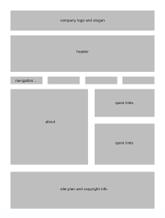
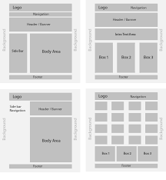
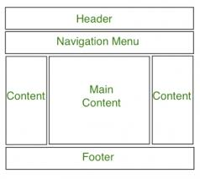
CSS Layouts
To create a webpage structure, CSS provides powerful tools likes
CSS Frameworks (Bootstrap, Foundation)
CSS Flexbox
CSS Grid

Slide 31
Web Layout (CSS Layout)
Web Layout is a design pattern to determine how elements are positioned, sized, and arranged within a web page. Here are some common CSS layout techniques:
Float Layout: Floats were traditionally used for layout before the advent of Flexbox and CSS Grid. Floating elements can be positioned to the left or right of their container, allowing text and other elements to wrap around them.
Flexbox Layout: Flexbox is a one-dimensional layout method for laying out items in rows or columns. It provides more control over the alignment, direction, order, and size of elements within a container. Flexbox is particularly useful for creating responsive layouts and aligning items within a container.
Grid Layout: CSS Grid Layout is a two-dimensional layout system for designing grid-based layouts in CSS. It allows you to divide a page into rows and columns, providing precise control over the placement and sizing of elements within the grid. Grid Layout is powerful for creating complex layouts and is well-suited for designing both full-page layouts and smaller components.

Slide 32
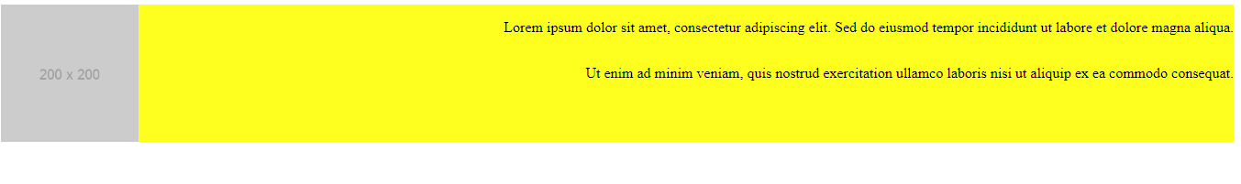
Floats
Floats in CSS are used to position elements to the left or right of their containing block, allowing text and inline elements to wrap around them. Float use left or right property to display items.
float: left/right;
Here image on left side and text on right side
Here nav items are displayed on right side

Slide 33
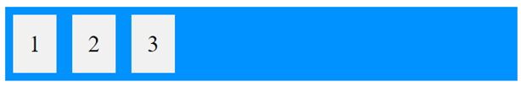
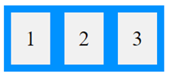
Flexbox Layout
Flexbox (Flexible Box) is a one-dimensional layout method for arranging items in rows or columns. Before Flexbox (2017) float and positioning layouts were reliable for cross-browser tools. The Flexible Box Layout Module, makes it easier to design flexible responsive layout structure without using float or positioning.
CSS use display property to decide the layout model.
display: flex
In above figure container is displayed as block-level content. To display container as inline content, use the value inline-flex as
display:inline-flex

Slide 34
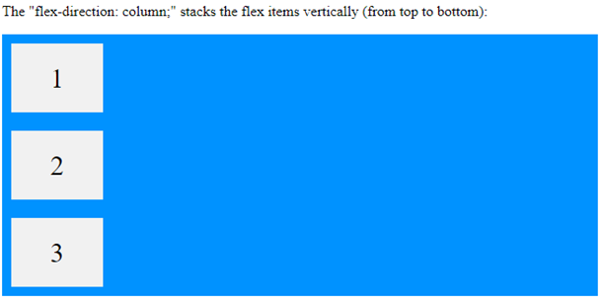
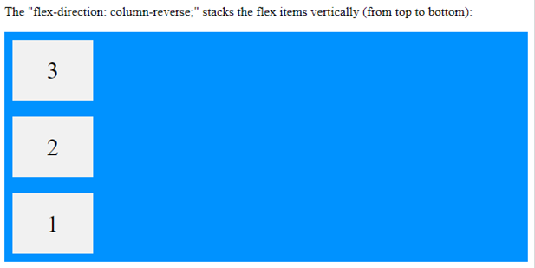
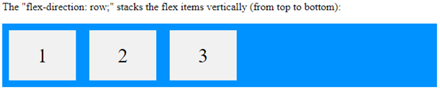
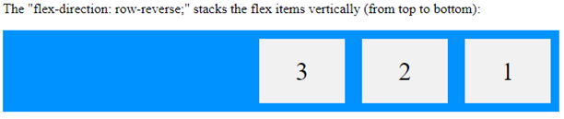
The Flex model
All items inside Flexbox layout are placed in term of row or column. The flex-direction property defines in which direction the container wants to stack the flex items.
flex-direction: row (default)|column | row-reverse | column-reverse

Slide 35
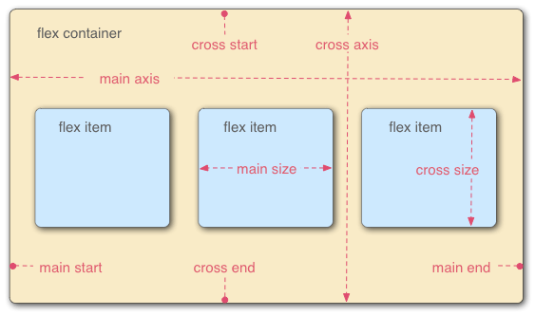
Flexbox main-axis vs cross-axis
All items inside Flexbox layout are placed in term of two axes – the main axis or cross axis defined by flex-direction property.

Slide 36
Flexbox Properties
flex-wrap: This sets whether flex items are forced onto one line or can wrap onto multiple lines.
flex-wrap: nowrap (default) | wrap | wrap-reverse;
wrap: The flexbox is multiline
nowrap: The flex containers is a single line
wrap-reverse: same as ‘wrap’ except the cross-start and cross-end‘’ directions are swapped.
flex-flow: This is shorthand for the flex-direction and flex-wrap
flex-flow: column wrap

Slide 37
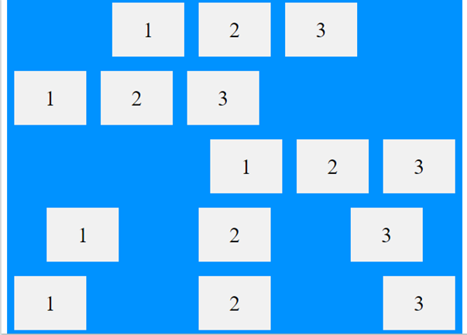
Alignment Property (justify-content)
The justify-content property is used to align the flex item. This define the alignment along the main axis.
justify-content: center | flex-start | flex-end | space-around | space-between | space-evenly
center
flex-start
flex-end
space-around
space-between

Slide 38
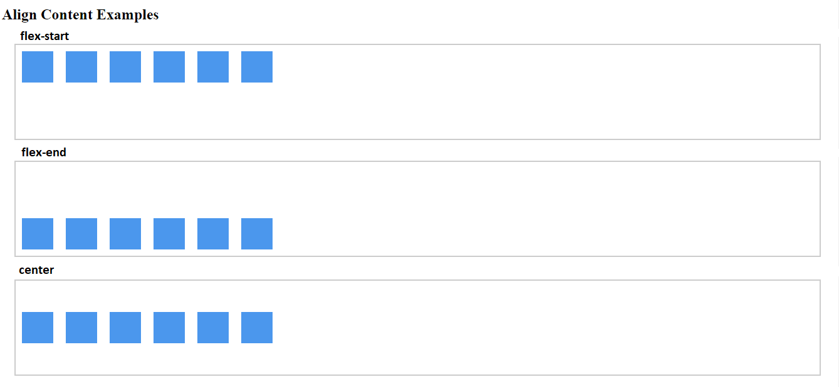
Alignment Property (align-content)
align-content aligns the entire set of flex lines (not individual items) within the flex container. The values could be
flex-start
flex-end
Center
space-between
space-around
space-evenly

Slide 39
Flexbox Properties
gap: The gap property explicitly controls the space between flex items. It can gap: | row-gap | column-gap
Perfect Center:- To align flex item perfectly center, use the justify-content and align-items properties.
container {
display: flex;
gap: 10px;
gap: 10px 20px; /* row-gap column gap */
row-gap: 10px;
column-gap: 20px;
}
.flex-container {
display: flex;
height: 300px;
justify-content: center;
align-items: center;
}

Slide 40
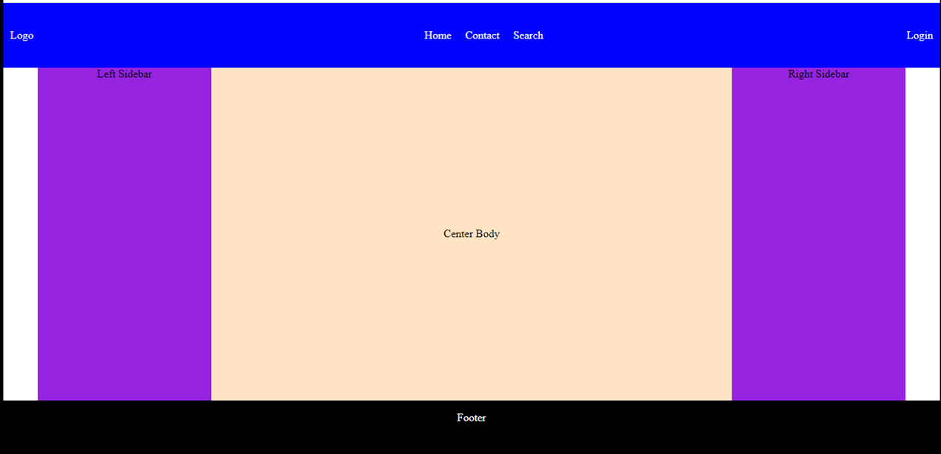
Flex Example

Slide 41
Flex Example
<body>
<div class="container">
<!-- Main Header -->
<div class="header">
<div> Logo</div>
<ul>
<li>Home</li>
<li>Contact</li>
<li>Search</li>
</ul>
<div>Login</div>
</div>
<!-- Main Body Area -->
<div class="main-content">
<div class="left-sidebar">Left Sidebar</div>
<div class="center">Center Body</div>
<div class="right-sidbar">Right Sidebar</div>
</div>
<!-- Footer Area -->
<div class="footer"> <p>Footer </p></div> </div>
</body>
<style>
body { margin: 0; padding: 0; }
.container {
height: 100vh;
display: flex;
flex-direction: column;
}
.header {
display: flex;
height: 100px;
background-color: blue;
color: white;
justify-content: space-between;
align-items: center;
padding: 10px;
}
ul {display: flex;}
ul li { list-style-type: none; padding: 10px; }
.footer {
color: white;
background-color: black;
display: flex;
height: 100px;
justify-content: center;
}
.main-content {
margin: 0px 50px 0px 50px;
padding: 20 20 20 20;
height: 100vh;
display: flex;
background-color: bisque;
}
.right-sidebar , .left-sidebar {
display: flex;
width: 20%;
background-color: blueviolet;
justify-content: center;
}
.center {
display: flex;
flex: auto;
justify-content: center;
align-items: center;
}
</style>

Slide 42
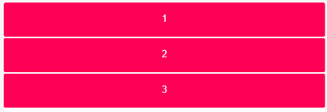
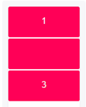
Grid Layout
CSS Grid Layout is a powerful two-dimensional responsive layout system for mobile, tablet, and desktop devices. It allows you to design complex web layouts with rows and columns.
To start with Grid layout, you have to define a html container element first with CSS display property as
.wrapper {display: grid}
Or
.wrapper {display: inline-grid}

Slide 43
Grid Layout
Here are some key component of CSS Grid Layout:
Grid Container: The element that contains the grid is referred to as the grid container. You can define an element as a grid container by applying the display: grid; or display: inline-grid; property to it.
Grid Items: The children of the grid container are called grid items. These are the elements that will be laid out within the grid.
Grid Lines: The horizontal and vertical lines that define the grid are known as grid lines. Grid lines divide the grid into rows and columns.
Grid Cells: The rectangular areas formed by the intersection of grid rows and columns are called grid cells. Each grid cell can contain one or more grid items.
Grid Areas: You can define named grid areas using the grid-template-areas property. This allows you to assign specific grid items to predefined areas within the grid.

Slide 44
Grid Layout
Grid Tracks: The spaces between two adjacent grid lines, either horizontal or vertical, are called grid tracks. These tracks can be explicitly sized using CSS properties like grid-template-columns and grid-template-rows, or they can be auto-sized to fit the content.
Grid Lines Numbering: Grid lines are numbered starting from 1. You can also use negative indices to count from the end of the grid.
Grid Template: You can define the structure of the grid using the grid-template-columns and grid-template-rows properties, which allow you to specify the size and number of columns and rows in the grid.
Grid Gap: The grid-gap property sets the size of the gap between grid tracks (rows and columns). It's a shorthand for grid-row-gap and grid-column-gap.
Alignment: CSS Grid Layout provides various properties to align and justify grid items within the grid, such as justify-items, align-items, justify-content, and align-content.

Slide 45
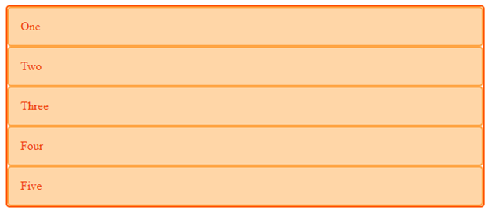
CSS Grid Layout (Implicit Gird Example)
CSS
.wrapper
{
display: grid;
border: 2px solid #670707;
border-radius: 5px;
background: #fff4ef;
}
.box {
border: 2px
solid #670707;
border-radius: 5px;
}
HTML
<div class="wrapper">
<div class =“box”> One </div>
<div class =“box”> Two</div>
<div class =“box”> Three</div>
<div class =“box”> Four</div>
<div class =“box”> Five</div>
</div>
All direct children of grid containers become grid items and display inside container ‘wrapper’ in single column by default

Slide 46
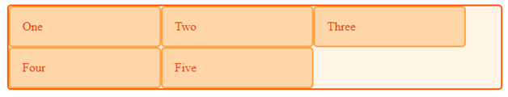
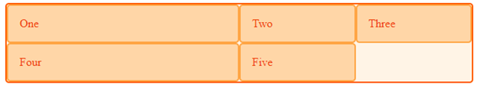
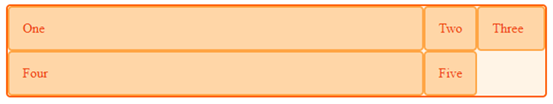
Grid Elements
The children (i.e. direct descendants) of the grid container are known are grid items (grid elements). By default grid items are display in single column.
Explicitly set a grid by creating columns and rows with the grid-template-columns and grid-columns and grid-template-rows properties.
To create a flexible grid item length, fr unit is used to represent fraction of the available space in the grid container.
grid-template-columns: 2fr 1fr 1fr;
grid-template-columns: 500px 1fr 1fr;
Value “auto” can be use to cover remaining space grid-template-columns: 80px auto auto
.wrapper {
display: grid;
grid-template-columns: 200px 200px 200px 200px;
}

Slide 47
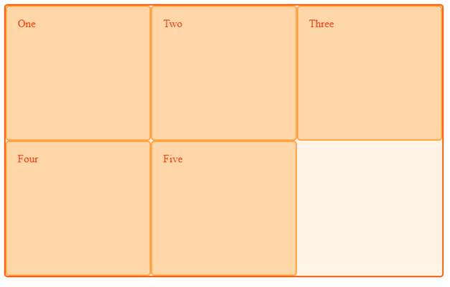
Grid Elements properties
repeat- Large grids with many tracks can use the repeat() notation, to repeat all or a section of the track listing.
grid-template-columns: 1fr 1fr 1fr; == grid-template-columns: repeat(3, 1fr);
- Mix of absolute size with flexible repeat
grid-template-columns: 70px repeat(3, 1fr) 70px;
grid-auto-row/grid-auto-column- These properties define the size for explicit columns or rows implicitly (default)
.wrapper {
display: grid;
grid-template-columns: repeat(3, 1fr);
grid-auto-rows: 200px;
}
Here grid-auto-rows define the height of a row inside grid-template-columns.
- When we create explicit grid by grid-template-columns property, the grid create rows its own implicitly, have auto-sized
by default, based on the content inside track.

Slide 48
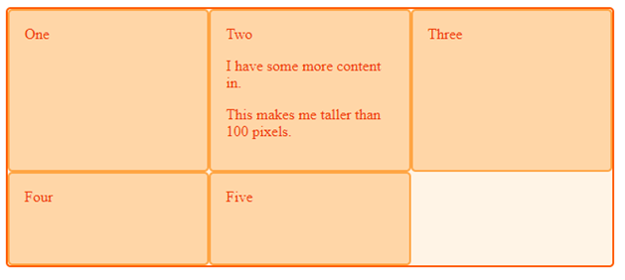
Grid Elements Properties
minmax: Using minmax() in the value of grid-auto-rows means that the size of row will be according to the size of inside content with minimum defined size.
.wrapper {
display: grid;
grid-template-columns: repeat(3, 1fr);
grid-auto-rows: minmax(100px, auto);
}
<div class="wrapper">
<div>One</div>
<div>
Two
<p>I have some more content in.</p>
<p>This makes me taller than 100 pixels.</p>
</div>
<div>Three</div>
<div>Four</div>
<div>Five</div>
</div>

Slide 49
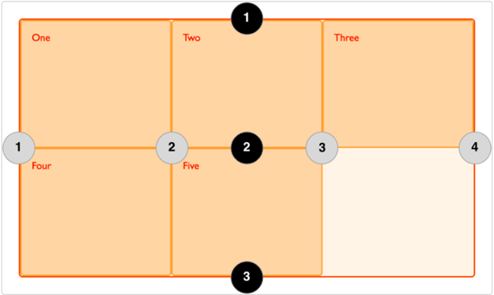
Grid Lines
In CSS Grid Layout, grid lines are the lines that separate the rows and columns of a grid. Still now, we have created grid by grid tracks to place items inside. Grid lines define the structure of the grid and provide the basis for placing grid items within the grid container.
In given figure, according to grid track, we have three
columns and two rows and according to grid line structure,
we have 4 lines or column and 3 lines of rows.
- Column lines are start from left to right
- Row lines are start from top to bottom.
Grid lines are defined by the following properties
grid-column-start
grid-column-end
grid-row-start
grid-row-end

Slide 50
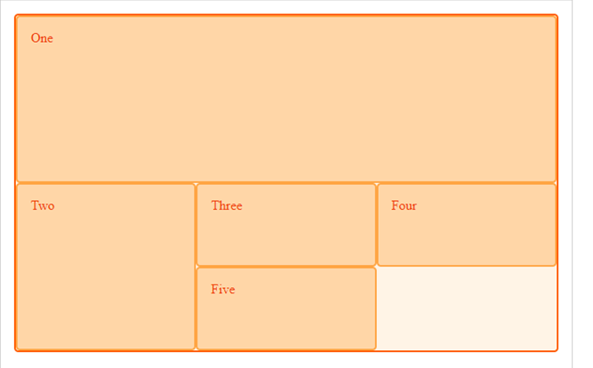
Grid Lines
.wrapper {
display: grid;
grid-template-columns: repeat(3, 1fr);
grid-auto-rows: 100px;
}
.box1 {
grid-column-start: 1;
grid-column-end: 4;
grid-row-start: 1;
grid-row-end: 3;
}
.box2 {
grid-column-start: 1;
grid-row-start: 3;
grid-row-end: 5;
}
<div class="wrapper">
<div class="box1">One</div>
<div class="box2">Two</div>
<div class="box3">Three</div>
<div class="box4">Four</div>
<div class="box5">Five</div>
</div>
.box1 {
grid-column: 1 / 4;
grid-row: 1 / 3;
}
Line positioning can be defined by ‘/’ for shortest notation

Slide 51
grid-row / grid-column properties
Grid-row & grid-column properties define, which row of column an element will be displayed on. You can use individual property as
grid-row: <row-start> / <row-end>;
grid-row: <row-start> / span <n>;
Both properties work in conjunction to define the placement of grid items within the grid container.
grid-column: 5;
grid-row: 3;
This conjunction will select cell in column 5 and row 3.
Span value of grid spread the column or row, start from start property.
grid-column-start: 1;
grid-column-end: span 4

Slide 52
Grid Gutter
Grid gutter is the space/gap between cells by using properties
column-gap: 50px;
row-gap: 50px;
The gap property is a shorthand property for the row-gap and the column-gap properties:
gap: 50px 100px;

Slide 53
Grid Alignment (justify-content vs justify-item)
To control the alignment of column or row, justify-content property is used.
Column alignment could be start | center | space-between | space-around | space-evenly
To control the alignment of items within row or columns, justify-item property is used
Item alignment could be stretch (default) | start | center | end
wrapper {
display: grid;
grid-template-columns: 90px 90px;
justify-content: center;
}
.parent {
display: grid;
grid-template-columns: 90px 90px;
justify-content: center;
justify-items: stretch;
}

Slide 54
Grid Alignment (justify-self)
justify-self:- This property is used to align a specific grid child.
Possible values could be stretch | start |end |center
justify-items is used on a grid container and is used to determine how grid items are spread out along a row by setting the default justify-self property for all child boxes. justify-self is used to set how an individual grid item positions itself along the row/inline axis.
.parent {
display: grid;
grid-template-columns: 90px 90px;
justify-content: start;
}
.one {
justify-self: start;
}

Slide 55
Grid Alignment (align-content | align-items)
To align grid stuff in horizontal direction, Grid provides align-content & align-items properties.
align-content is like justify-content, but it affects rows instead of columns. Similarly, align-items is like justify-items, but it handles the vertical alignment of items inside their grid area, rather than horizontal.

Slide 56
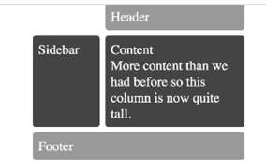
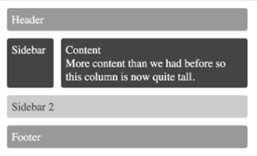

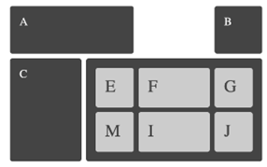
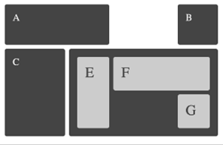
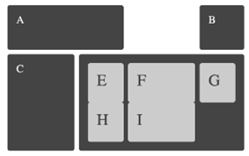
Grid Examples

Slide 57
How to Define Grid Layout
Define the Grid: You can define the structure of the grid using properties like grid-template-columns and grid-template-rows on the grid container. These properties allow you to specify the size and number of columns and rows in the grid.
Place Grid Items: Once the grid is defined, you can place the grid items within the grid using properties like grid-column and grid-row. These properties determine which grid lines the items start and end on, effectively positioning them within the grid.
Alignment: Grid containers provide properties to align and justify grid items within the grid, such as justify-items, align-items, justify-content, and align-content. These properties control the alignment of items along the row and column axes.
Grid Gap: You can also specify the size of the gap between grid tracks (rows and columns) using the grid-gap property or its shorthand equivalents grid-row-gap and grid-column-gap.
Responsive Layouts: CSS Grid Layout allows you to create responsive layouts that adapt to different screen sizes and orientations. By using flexible units like percentages or fr units, you can create layouts that adjust dynamically based on the available space.

Slide 58
Flexbox vs Grid Layout
Flexbox is consider for small-scale layouts, whereas Grid layout is intended for large scale layouts.
Grid is a two dimension layout model, which control column and rows together.
Flex is a one-dimensional layout means that layout in one dimension at a time – either as a row or as a column.
All items inside Flexbox layout are placed in term of row or column. The
flex-direction property defines in which direction the container wants to stack the flex items.

Slide 59
Practice Page
https://gridbyexample.com/
http://www.flexboxdefense.com/
https://flexboxfroggy.com/
https://gridcritters.com/
https://cssbattle.dev/

Slide 60
Reference:-
https://developer.mozilla.org/en-US/docs/Web/CSS/CSS_grid_layout/Basic_concepts_of_grid_layout
https://www.joshwcomeau.com/css/interactive-guide-to-grid/
https://css-tricks.com/snippets/css/complete-guide-grid/
Grid Examples:-
https://gridbyexample.com/examples/

Slide 61
CSS Positioning
CSS positioning refers to the way elements are arranged on a web page using the position property. There are five common values:
Static (default): Elements are positioned in the normal document flow.
Relative: Positioned relative to its normal position.
Absolute: Positioned relative to its nearest positioned ancestor or the viewport if none exists.
Fixed: Positioned relative to the viewport; doesn't move on scroll.
Sticky: Switches between relative and fixed, depending on scroll position.
Each position can be displayed by top, right, bottom, and left properties

Slide 62
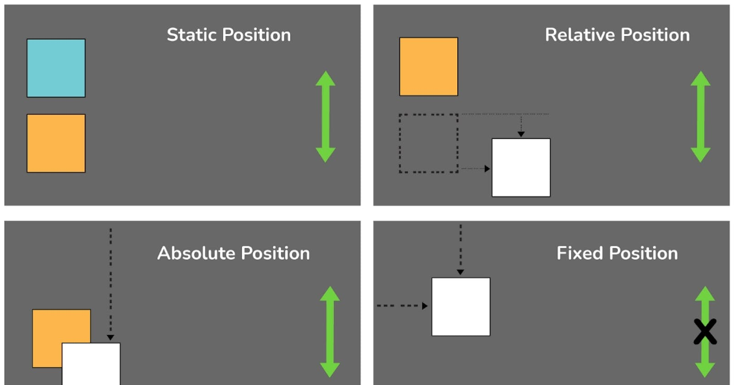

Slide 63
CSS Positioning
Static Potion:- The static position is the default position of an element in CSS. This means that the element is positioned according to the normal flow of the document.
All elements are static by default unless otherwise specified.
The top, right, bottom, and left properties have no effect when the position is set to static.

Slide 64


CSS Positioning
Relative Position:- When an element is positioned relatively, it’s positioned relative to its original (static) location in the normal document flow.
You can move it using the top, right, bottom, and left properties without affecting other elements' positions.
Z-index value define the element overlapping.
Examples
Relative Positioning for a Tooltip
Button with Floating Label

Slide 65
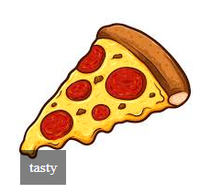
CSS Positioning
Absolute Position:- An absolutely positioned element is removed from the normal document flow and positioned relative to its nearest positioned ancestor (any element with relative, absolute, or fixed positioning).
The top, right, bottom, and left properties are used to position it from ancestor precisely .
Without the ancestor having relative, absolute of fixed positioning, the absolute element would be positioned relative to the viewport.
Ideal for creating elements like floating tooltips, pop-up modals, or overlay text on images.
Example

Slide 66
CSS Positioning
Fixed Position:- Elements with fixed positioning are removed from the normal document flow and are positioned relative to the browser window (viewport). This means the element stays fixed at a specified position even when the user scrolls. Properties left, right, up, bottom take effect
Use-Cases:-
Sticky Header: Keep navigation or important information visible while scrolling.
Persistent Footer: Keep key information, such as contact info, always accessible at the bottom of the page.
Fixed Sidebars: Useful for websites that need a sidebar for navigation that remains accessible while scrolling the main content.
Alert Bars: Used on websites to show urgent or important messages that users can always see while navigating.
Scroll Navigation: This is commonly used on long pages to give users an easy way to scroll back to the top.

Slide 67
CSS Positioning
Sticky Position: sticky allows an element to "stick" to a specific position when the user scrolls past it, behaving like relative until that point and fixed afterwards.

Slide 68
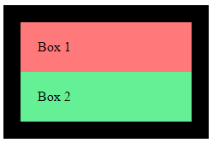
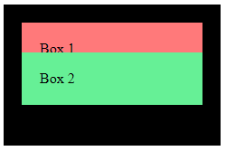
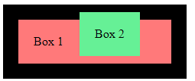
Static Position
Relative Position
Absolute Position
<style>
.relative-container {
background-color: black;
width: 200px;
padding: 20px;
} .box1 {
background-color: lightcoral;
padding: 20px;
} .box2 {
position: relative;
background-color: lightgreen;
padding: 20px;
top: -25
}
</style>
<style>
.relative-container {
position: relative;
background-color: black;
width: 200px;
padding: 20px;
}
.box1 {
background-color: lightcoral;
padding: 20px;
}
.box2 {
position: absolute;
top: 10px;
left: 100px;
background-color: lightgreen;
padding: 20px;
}
</style>
<style>
.relative-container {
background-color: black;
width: 200px;
padding: 20px;
}
.box1 {
background-color: lightcoral;
padding: 20px;
}
.box2 {
background-color: lightgreen;
padding: 20px;
}
</style>

Slide 69
Important properties
CSS z-index determines the stacking order. Elements with higher z-index values will be layered on top.
CSS transform is a powerful property that allows you to apply 2D or 3D transformations to an element, affecting its position, size, and shape without altering the document flow. Its value could be translate, rotate, scale, skew, materix.
translate(x, y): transform: translate(50px, 100px);
Moves an element from its original position.

Slide 70
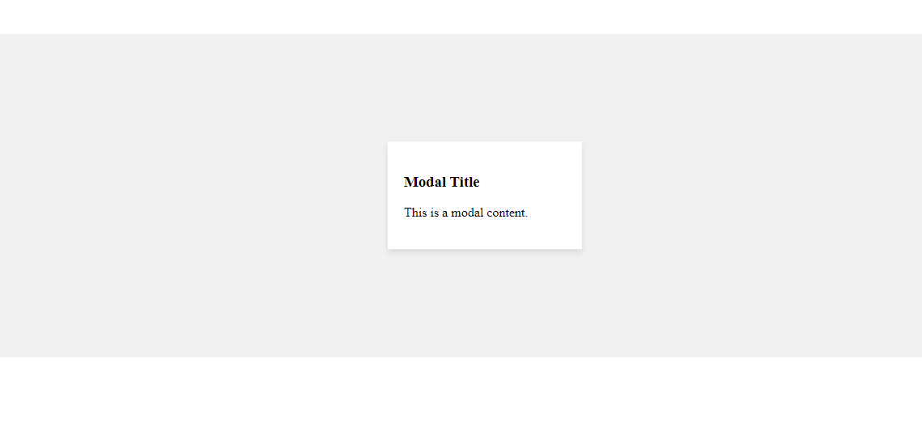
Best Examples
Absolute positioning is used to center pop-up modals on the page or within a container.
.modal-container {
position: relative;
height: 400px;
margin-top: 100px;
background-color: #f1f1f1;
}
.modal {
position: absolute;
top: 50%;
left: 50%;
transform: translate(-50%, -50%);
width: 200px;
padding: 20px;
background-color: white;
box-shadow: 0 4px 8px rgba(0, 0, 0, 0.1);
}
<div class="modal-container">
<div class="modal">
<h3>Modal Title</h3>
<p>This is a modal content.</p>
</div>

Slide 71
Beautiful Nav-Bar
<style>
nav {
background-color: #333;
overflow: hidden; /* Clears float */
}
nav ul {
list-style-type: none;
margin: 0;
padding: 0;
}
nav ul li { float: left;
display: inline;
margin-right: 20px;
padding: 10px;
}
nav ul li a {
color: white;
text-decoration: none;
padding: 14px 20px;
display: block;
}
nav ul li a:hover {
background-color: #575757;
}
This will display beautiful navbar, which float on left side.
Normally, we display <li> items as ‘display: inline;’ but her we used
<a> as ‘display:block’ to improving usability for navigation menus.
It also enables you to apply padding and margins effectively,
creating a better visual structure and layout for the navigation links.
This makes the menu easier to interact with, especially on touch devices.
<nav>
<ul>
<li><a href="#">Home</a></li>
<li><a href="#">About</a></li>
<li><a href="#">Services</a></li>
<li><a href="#">Contact</a></li>
</ul>
</nav>

Slide 72
Deliverable Name | Due Date | Semester
FYP Idea | 3rd Week (Tuesday) | 6th Semester
Proposal Submission | 5th Week (Tuesday) | 6th Semester
Proposal Defense | 6th Week | 6th Semester
Phase-1 Chapter-1 Submission | 12th Week | 6th Semester
Phase-1 Chapter-1 Evaluation | 13th Week | 6th Semester
Phase-1 Submission | 14th Week | 7th Semester
Phase-1 Evaluation | 17th Week | 7th Semester
Phase-II Submission | 14th Week | 8th Semester
Phase-II Evaluation | 17th Week | 8th Semester

